Slide 1

POLY-MORPHISM

Slide 2
SESSION OVERVIEW:
METHOD OVER-RIDING
POLY-MORPH-ISM
OPERATOR OVERLOADING
+ OPERATOR
< OPERATOR

Slide 3
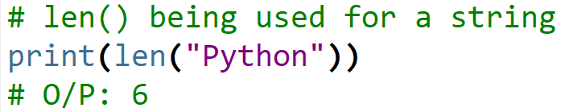
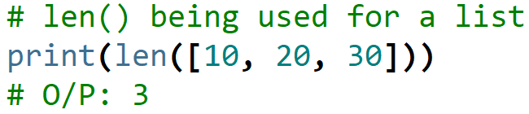
What is Polymorphism ?
The word polymorphism means having many forms.
In programming, polymorphism means same function name being uses for different datatypes.

Slide 4
TYPES
Inbuilt Functions
User Defined Functions
With Class Methods
With Inheritance
With A Function And Objects

Slide 5
Polymorphism with Inheritance
In Python, Polymorphism lets us define methods in the child class that have the same name as the methods in the parent class.
In inheritance, the child class inherits the methods from the parent class.
However, it is possible to modify a method in a child class that it has inherited from the parent class.
This is particularly useful in cases where the method inherited from the parent class doesn’t quite fit the child class.
In such cases, we re-implement the method in the child class.
This process of re-implementing a method in the child class is known as Method Overriding.

Slide 6
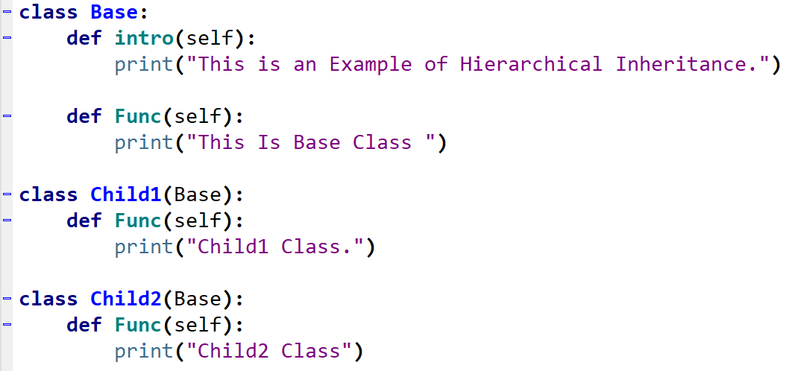
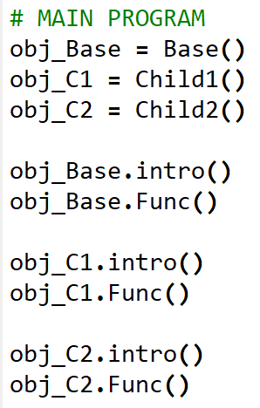
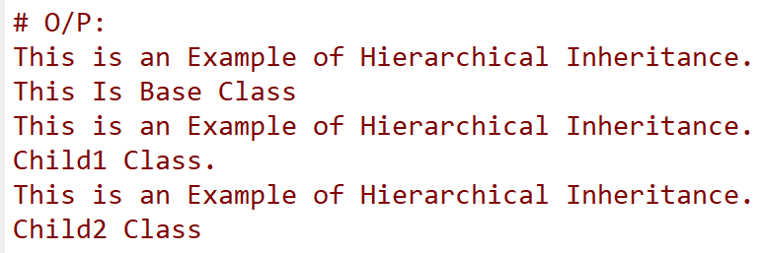

Slide 7
Operator Overloading
Operator Overloading means giving extended meaning beyond their predefined operational meaning.
For example operator + is used to add two integers
as well as join two strings and merge two lists.
It is achievable because ‘+’ operator is overloaded by int class and str class.
You might have noticed that the same built-in operator or function shows different behaviour for objects of different classes, this is called Operator Overloading.

Slide 8
Python Special Functions
Class functions that begin with double underscore __ are called special functions in Python.
These functions are not the typical functions that we define for a class.
The __init__() function we defined above is one of them. It gets called every time we create a new object of that class.
There are numerous other special functions in Python.
Using special functions, we can make our class compatible with built-in functions.

Slide 9
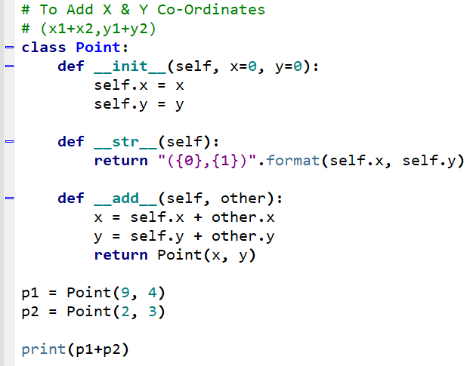


Slide 10
OVERLOADING + OPERATOR
__init__() function gets called every time we create a new object of that class.
__str__() method in our class that controls how the object gets printed.
To overload the + operator, we will need to implement __add__() function in the class.
With great power comes great responsibility.
We can do whatever we like, inside this function.
But it is more sensible to return a Point object of the coordinate sum.

Slide 11
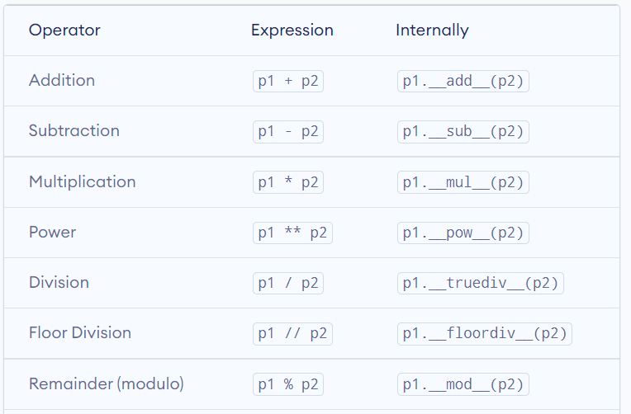

Slide 12
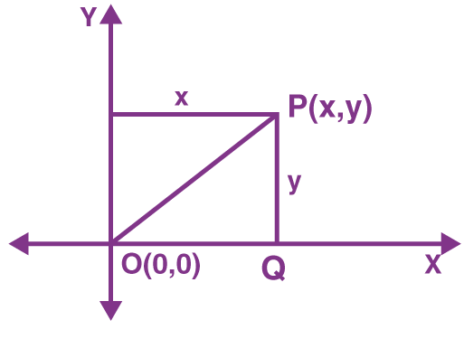

OVERLOADING < OPERATOR
Python does not limit operator overloading to arithmetic operators only. We can overload comparison operators as well.
Suppose we wanted to compare the magnitude of these points from the origin and return the result for this purpose.

Slide 13
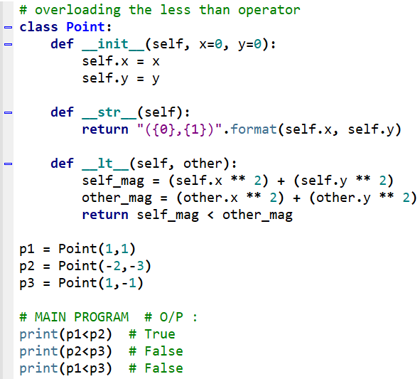

Slide 14
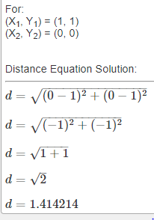
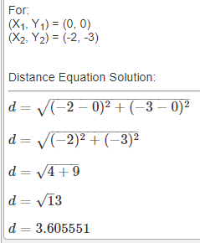
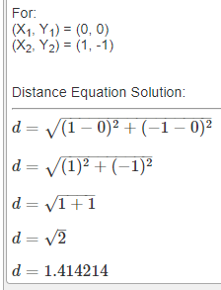
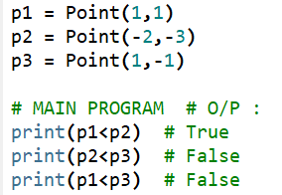

Slide 15
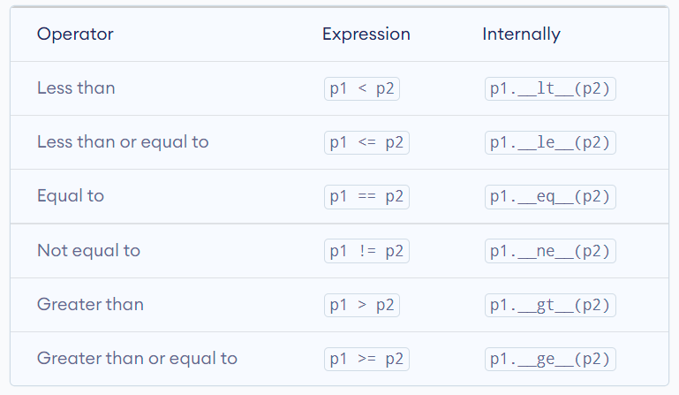

Slide 16

CODING IS FUN ! THANK YOU !!

